Slide 1
FDC PoC Approach
Presented to: <<>>

Slide 2

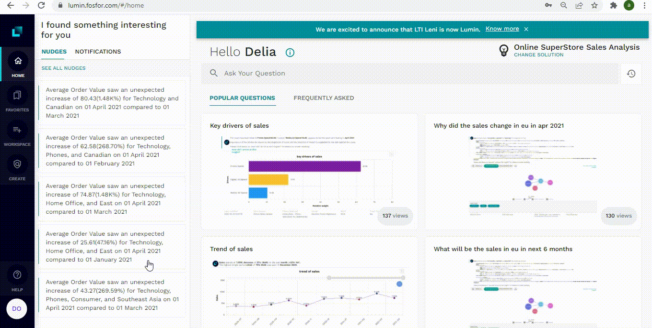






Lumin transforms curiosity into limitless insight
The fastest way to get to the business insights that matter most!
Live Querying,
Beyond Insights
Autonomous Nudges
Insight Explainability
Data
Storytelling
Rapid
Configuration
Composability via SDKs & APIs

Slide 3
How do we engage with customers on a proof-of-concept
1
2
3
Pre-POC
Proof-of-Concept
Post-POC
Use case Definition
Success criteria finalization
Lumin setup – client cloud or SaaS (incl. necessary approvals)
Data pre-requisites
Business behavior understanding
Data exploration and preparation (if needed)
POC Solution configuration
POC accomplishments and feedback
Engagement Models

Slide 4




POC Timelines
POC Setup Timelines
Biz Test Drive
Phase
Activities
Timeline
Use case definition
Infra allocation
Lumin Setup
Initial Data Exploration
W0 | W0 | W0 | W1 | W2 | W3 | W4 | W5 | W6
Pre-POC
Business interactions
Data Exploration & Prep
Data connect with Lumin
Solution Configuration
Configure
POC
Phases
Lumin walkthrough
Data validation
Business Test-drive
Validate
POC Readout
Finalize Plan for Production
Finalize Licensing Models
Post POC
Post POC

Slide 5





POC – Staffing needed
LTIM Team
Client Team
INDIA
US
Lead Lumin Specialist
Project Manager
Client POC
Solutions Engineer
Lumin Config Specialist(s)
Data Prep Specialist
(if needed)
Business SME
GOVERNANCE
LTI Account Manager
Fosfor Manager
Daily and Weekly Cadence will be scheduled with stakeholders based on availability

Slide 6
RACI Matrix
Key Tasks |  |  | LTIMindtree | 7-Eleven
Infrastructure Provisioning for Installation |  |  | C,I | R,A
Lumin Installation and Testing |  |  | R,A | I
Solution Configuration |  |  | R,A | I
Testing and Validation |  |  | R,A | C,I
Business User Trial |  |  | C,I | R
User Support |  |  | R,A | C,I
Legend | R: Responsible | A: Accountable | C: Consulted | I: Informed

Slide 7
Pre-POC Overview
USE CASE: SALES PERFORMANCE ANALYSIS
Enabling 7-Eleven’s business users with self serve exploration capabilities to conduct on-the-fly deep dives and get autonomous nudges to analyze key sales metrics to help improve engagement strategies
Features | Description
Ask Lumin | Ability to ask question in natural language
Explore | Descriptive summarization, slicing and dicing
Diagnose | Explain changes in business metrices
Forecast | Univariate & Multivariate forecasting of KPIs
Nudges | Autonomous anomaly detection
Simulate | Simulate Decision scenario based on key drivers
Recommendations | Next best question to be asked
Smart Narratives | Natural language explanations of answers
XAI | Build trust in how Lumin come up with an insight
Storytelling | Creating stories and sharing workspaces for collaboration
NLP Search Experience answering questions
80%
SUCCESS CRITERIA
Accurate Display of Results
100%
Relevant visulaizations and narratives
100%
Relevant Nudges generated
100%
Relevant Explainability behind insights
100%

Slide 8
POC – Sales Analysis
Analysis of Key Sales Metrics for the Business Organization across dimensions leveraging last 3 years of data.
DATA FORMAT AND TYPE
To be confirmed
MEASURES
SALES
DELIVERY
KEY DIMENSIONS
BUSINESS UNIT
PRODUCT
CATEGORY
STORE
REGION
DATE DIMENSIONS
ORDER DATE
BUSINESS HIERARCHY
LOCATION
KEY KPI’s CALCULATED*
UNITS
DELIVERY UNITS
APSD

Slide 9
Indicative Lumin Insights
EXPLORE (What, Where, When)
DIAGNOSTICS (Why)
FORECAST (What will be)
SIMULATE (What will be)
NUDGES (Outlier Detection)
Why has the sales dropped in Q1 2023?
Why the Unit sold in the Electronic BU has increased in May 2023?
Number of Unit Sold
Delivery Units/Sales decrease/increase based on key dimensions
What will be the sales for Non-alcoholic beverages in 3 months?*
What will be the Unit sold in next 2 months?*
What if the Units is increased by 10%, impact on Sales will be?*
What is the trend of sales in 2022?
When has sales been the highest in last 12 months?
What is the sales by Category for FY 2022?
Top 5 product by sales in last month?
* Note: Forecasting and simulations insights are dependent on key measures converging and model fitment

Slide 10
Lumin POC pre-requisites
Use case definition
What is the use case and business outcome? Which personas will be consuming the analysis on Lumin?
What are some KPIs /calculated fields that need to be incorporated as part of the POC?
Infra Feasibility
How many users would need access to the POC instance? What is expected concurrency?
What SSO protocol do you use? (Required for post POC phase)
Are there any existing reports, insights against which the POC outcome needs to be validated/ reconciled?
What deployment infrastructure would be preferred post the POC?
Data Exploration
What are the Data Sources to be considered for Lumin to connect?
What are the types of data available? Do you have longitudinal data?
What is the data refresh frequency? (Required for post POC phase)
What is the approximate data size – for POC and post POC?
Do you have a data dictionary available? Are the join logics between data tables defined or need to be identified? Is there a hierarchy available in the data?

